Slide 1

Secure Nurture Pvt. Ltd.
Providing value-driven IT solutions across global industries & domains
Secure Nurture Pvt. Ltd.

Slide 2



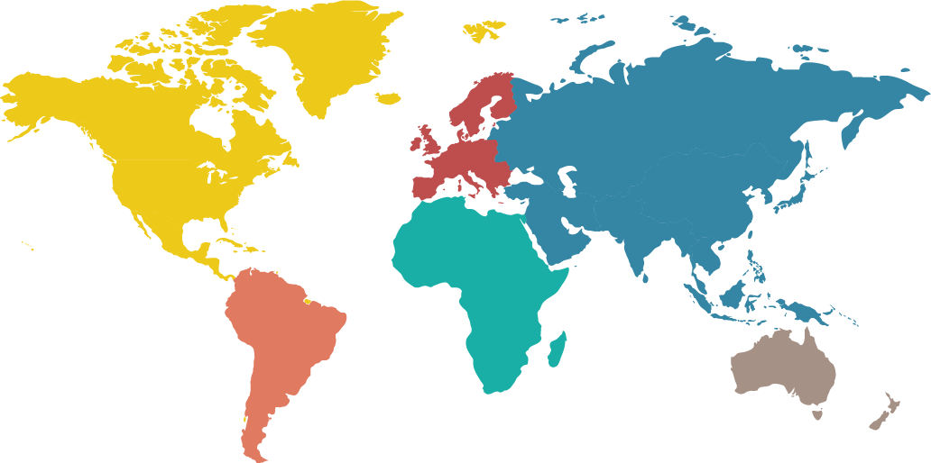


We are…
Global technology services
firm focused on digital transformation.
We help customers with the in-depth knowledge and transparency on licensing solutions and technology advisory services that can deliver cost effective solutions.
UK- London
USA- California
INDIA - Gurgaon
INDIA - Bangalore
50+
Consultants
8+
years of rich experience
80
Projects delivered
Secure Nurture Pvt. Ltd.

Slide 3

Our Services
IT Services & Solutions
Associated Product Lines
02
ERP & HRMS solutions
CRM Implementation
Web Development / Application
Training
Cloud Services
Analytical Tools
Server & Link load balancers
Security Products / Applications
Asset Management
01
Advisory
03
Software Licensing
Strategic Sourcing
Network Services
Strategic Reselling
IT Consulting
Secure Nurture Pvt. Ltd.

Slide 4
Service Dimensions
Vertical 1
Vertical 2
Vertical 3
Product Implementation:
Salesforce
Microsoft
Keka
Ramco
Adobe
SNPL Products
Development & Support:
Integrations
Migrations
Upgrades
Consulting
SharePoint
Custom SOW
Resource Augmentation:
Salesforce
MS D365
SAP
RVW
SQL
DevOps
PHP, .NET, JAVA

Slide 5
Our Value Offerings in Product Implementation:
Vertical 1
SNPL’s Education Industry Product
Our Educational software product aims to enhance teaching and learning practices, making them more accessible, Skill-enabled and goal-oriented. However, There are certain things that need to be kept in mind to ensure good quality of the solution during implementation. Let’s look at some of the basic characteristics of our Skill linked solution:
Easy to use UI (user interface): An ideal interface is applicable with icons, menus, and search bar so the user can easily switch between different activities and tasks include eye-catching graphics, themes, and designs
Feedback features: If students engage with feedback and referrals, it can help enhance learning and improve assessment performance.
Interactive learning: The content provided in an education software should be interactive and understandable as every student is not a quick learner. This feature allows for open-ended exploration of topics which helps develop critical thinking skills. Studies also show that interactive learning helps students with information retention.
Process Connected: Our product covers most of the activities that are used in a Skill and training provider Agency/Organization i.e. Sales, Marketing, Procurements, Finance, Operations, Maintenance etc.

Slide 6
Our Value Offerings in Customization & Support:
Vertical 2
Application Support and Feature enhancements:
SNPL provides technical support services for stand-alone software and components as well as for the entire infrastructure and comprehensive application solutions. Support is available in all time zones within standard working hours or 24x7 (subject to agreement terms). Services are provided by certified experts.
Basic technical support Free advice on basic functionality Incident support. One-time execution of consulting and technical services Optimum technical support. A wide range of solutions support options
Outsource for cost-efficiency and convenient outsourcing for routine maintenance tasks to a qualified service provider/client, to focus on their Business and innovations goals. By leveraging expertise and world's best practices, SNPL experts are able to ensure fail-safe IT operations and even predictive incident by fixing problems proactively before it occurs.

Slide 7
Our Value Offerings in Resource Augmentation:
Vertical 3
We strongly believe in SAAS that enables Solution As A Service.
Our experience with industries’ best players, providing extension to your team
Access to biggest resource pool; no risks from long-term resource association
Video visibility of your team
Up-scaling and Down-scaling of expertise focused resources; eliminating risk factor.
Less financial liabilities and obligations for contractual resources.
Zero investment in office infrastructure
Secure Nurture Pvt. Ltd.

Slide 8












Industries we serve:
Bank
Insurance
Transport
Retail
Energy
Consumer Goods
Education
Health Care
Travel
Manufacturing
Information Technology
Communication
Secure Nurture Pvt. Ltd.

Slide 9










Our Technology Alliances
Secure Nurture Pvt. Ltd.

Slide 10














Our Clientele:
Secure Nurture Pvt. Ltd.

Slide 11
Let’s Team Up!
How can we help?
info@securenurture.com
Secure Nurture Pvt. Ltd.

